Slide 1


Hockeypuck

Slide 2

What the 'Puck?
Public key server
Developed in pure Go
MongoDB storage
Notes:
Hockeypuck is a public key server developed in pure Go and uses MongoDB for data storage.

Slide 3

Public Key Servers
Public keys
Public service
Alice and Bob at a keysigning party.
Notes:
A bit of background and review...
What do we mean by public keys and public key servers?
Public key cryptography provides two important security features: authentic and confidential communication.
Each user in a public key cryptosystem creates their own pair of keys, a public and private key. These keys work together. The private key can decrypt messages enciphered with the public key. The public key can authenticate digital signatures made by the private key.
Public key servers distribute these public keys, as a public service to users of public key cryptography.

Slide 4
GnuPG Keyserver Example
$ gpg --keyserver keyserver.gazzang.net --search-keys casey.marshall@gazzang.com
gpg: searching for "casey.marshall@gazzang.com" from hkp server keyserver.ubuntu.com
(1) Casey Marshall <casey.marshall@gmail.com>
Casey Marshall <casey.marshall@gazzang.com>
3072 bit DSA key 44A2D1DB, created: 2012-03-05
Keys 1-1 of 1 for "casey.marshall@gazzang.com". Enter number(s), N)ext, or Q)uit >
Notes:
Hockeypuck serves PGP public keys used for secure email and other applications.
Here, I'm doing a lookup on my own key with GnuPG, free and open source implementation of the OpenPGP standard. keyserver.gazzang.net is running Hockeypuck.

Slide 5
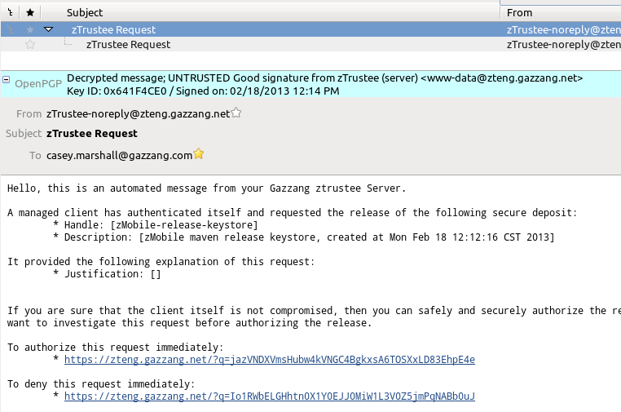
E-Mail
Notes:
Here is an OpenPGP encrypted email, this is the Enigmail for Mozilla Thunderbird, which uses GnuPG for the crypto operations.
OpenPGP is commonly used to encrypt and sign email messages, adding authenticity and confidentiality to an insecure medium.
This is an automated message sent by our key management service, Gazzang zTrustee. You can register your public key with zTrustee, and it will securely confirm access to sensitive data with PGP mail.

Slide 6
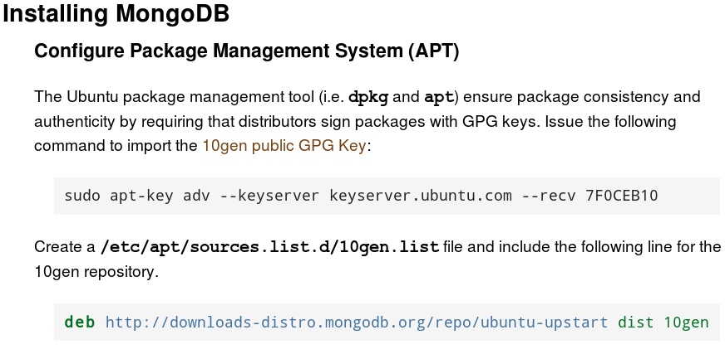
Verifying Software Packages
Notes:
OpenPGP is also commonly used to verify the authenticity of Linux software packages in many distributions.
A Linux distribution comes with a set of pre-loaded, trusted keys for verifying packages. Keys of third-party vendors can be added to this list. Here we are adding the 10gen public key to install MongoDB.
This alone provides a high level of security and authenticity to Linux software distributions that few operating systems match. This provides a cryptographically-strong chain of custody from the maintainer to the end user. It is important to verify and trust the hash on the original installation media. This trust then transfers to all software signed by the distribution keys.
Other OSes are just now adopting digital signatures to secure distribution. Debian has been securing packages with OpenPGP since 2006. ("Secure APT". Debian Wiki. Archived from the original on 1 September 2006. Retrieved 2006-09-05.)

Slide 7
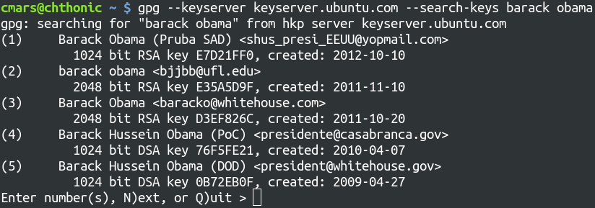
OpenPGP, Key Servers and Trust
Distribute keys and certificates
GnuPG only validates the keys
User validates the key's actual owner
Why we have key signing parties
Notes:
Public key servers are great for distributing keys. But it's important to note their limitations.
Key servers, and the keys they provide cannot be trusted by themselves. Anyone can make a key. Anyone, with a bit of research, could run a keyserver.
It's like what you'd get if Wikipedia made a phone book, and we still used phone books.
Good PGP software will always verify a key's self-integrity. All the information about that key (email addresses, thumbnail pics, encryption subkeys) should have a signature made by that key -- at least proving that the private key owner made the assertion! I have a little story to tell later about what happens when we don't verify self-signatures.
I know.. let's send the President a message with PGP. There are several results here... which identity should I choose?
None of them! I don't know who created any of these keys, only that they are keys! I have no other means to corroborate them!
We can only trust keys by some outside knowledge of their true ownership. Authenticity and trust have always been major problems with public key cryptosystems. These problems are still with us today. More on this later.

Slide 8
OpenPGP Key Servers
HKP (HTTP Keyserver Protocol)
Read Operations
  http://keyserver.gazzang.net/pks/lookup?
  search=keyword "Fingerprint" or shortened suffix
  op=get
  op=index, op=vindex
Write Operations
  http://keyserver.gazzang.net/pks/add
  Merge key material (new signatures, revocations)
PKS (SMTP Protocol)
  ADD, GET, INDEX, ...
Notes:
OpenPGP key servers use a simple, effective, RESTful web API to search, add and update public keys.
/pks/lookup is used to search for keys and either download them for local use or get summary information on multiple matching results.
/pks/add is used to upload new keys and update existing keys.
The keyserver is responsible for merging this information properly. A key update might contain a new email address, a new subkey that should be used to encrypt new messages, or revocations made by the owner to indicate the key is no longer valid. A good keyserver will do additional verification to check the integrity of the key material.

Slide 9
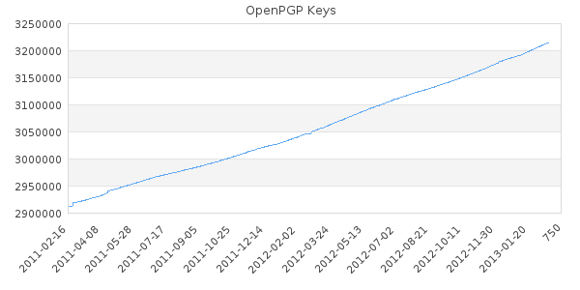
SKS: Synchronizing Key Server
Berkeley DB storage
Global distributed database
SKS global pool
Source: KF Webs, https://sks-keyservers.net/status/key_development.php
Notes:
The most popular key server today is SKS, the Synchronizing Key Server. SKS fully implements the HKP protocol, and distributes keys far and wide with an advanced protocol for database database replication at the application layer. The replication protocol is quite advanced, and the subject of academic research by Yaron Minsky and Ari Trachtenberg.
There is a constant growth in the number of new keys, indicating activity. Some keys are generated by automated processes and services (like software distribution), and some are probably lost or abandoned.
Prior to SKS, OpenPGP key servers typically shared keys over SMTP. SKS synchronization is much faster and easier on the network. And, as you can see here, the global pool of keys keeps growing.

Slide 10
Gazzang zTrustee
Commercial Key Management Service
Opaque object store
"You get what you put"
Built on OpenPGP
Our server cannot decrypt (unless you want)
Multi-factor authorization (E-mail or API)
PGP keyserver (SKS) for key distribution
  Problems under load
  Spikes of heavy writes
  Cached delays in key material unacceptable
Notes:
Full disclosure: zTrustee is a commercial key management service I develop at Gazzang. It's not free and not open source (yet), but it is built on 100% open source, and on OpenPGP.
zTrustee is a secure object storage system. It can store any small, sensitive piece of data (documents, objects, passwords, private keys) securely. So securely, we can't even decrypt your secrets. zTrustee clients uses OpenPGP to securely encrypt messages to themselves and other clients, and to authenticate themselves with a zTrustee server. The initial key exchange occurs over SSL. zTrustee adds multiple factors to the release of the opaque secret by adding trustees to the process. A trustee can authorize or deny the release of data with nonce web links sent in an email (plaintext or PGP-encrypted), our zMobile app, or with our HTTP API that is secured with PGP authentication.
---
We had some problems with SKS when stress-testing zTrustee. SKS is a fine piece of software, which I have come to greatly respect. During testing, zTrustee showed potential to place a much heavier load on SKS than it was ever designed for. At Gazzang, we were building something new with OpenPGP and placing new demands on it.
First, we found that Berkeley DB leaks mutexes under heavy load. The result of this is an unresponsive SKS process that requires offline recovery to restore. As a workaround, we had to regularly restart the service before hitting this wall. This also required adding some resilience to our application (backoff-retry on keyserver operations).
Second, we ran into hard limits on the number of concurrent connections SKS could support. SKS is a single-threaded web service. It functions well behind a caching proxy, where traffic is relatively infrequent. For zTrustee, we felt that key signatures and revocations needed to propagate much faster, or this would introduce security and usability problems. Caching was not an option, we needed a more scalable key server.
Finally, we were thinking up new features for keyservers all the time. We wanted to extend the HKP protocol and applying the key server concept to other cryptosystems. Unfortunately, none of us were very familiar with Ocaml.

Slide 11
Hockeypuck
Go lang, Go!
Simplicity, modularity
  Small, well-made pieces, fitting together
"Static duck typing"
So many batteries
  HTTP server & template library
  OpenPGP implementation
  Database drivers: mgo, pq, etc.
Concurrency
  Synchronous, message-passing through channels
  Asynchronous-like performance
Notes:
I had positive experiences with Go with a proof-of-concept side-project. I decided to develop my own HKP server in Go.
Development is fun again
I fell in love with the simplicity of the language. Go conspicuously leaves out many modern constructs you'd expect in a modern language: runtime exceptions. templates. class inheritance. It's opinionated, but the opinions are unix-y. Which is no surprise, since the language was created by Rob Pike and Ken Thompson.
This seems very strange and takes some getting used to. The funny thing is, once I got used to it, I found that I didn't miss these things at all, and I became more productive without them.
How do I hold all these batteries?
The Go standard library provides an HTTP web server and template library -- enough web framework for a RESTful service. The "mgo" driver developed by Gustavo Niemeyer blends very well with the Go language -- structs flow easily into and out of MongoDB.
Most importantly, Go has a native OpenPGP implementation, supporting reading and writing of key material, as well as encrypting and signing operations.

Slide 12

Architecture
Notes:
Let's explore the architecture of Hockeypuck. The concept of a web service like this, at its essence, is to turn web requests into responses, as quickly and efficiently as possible.

Slide 13
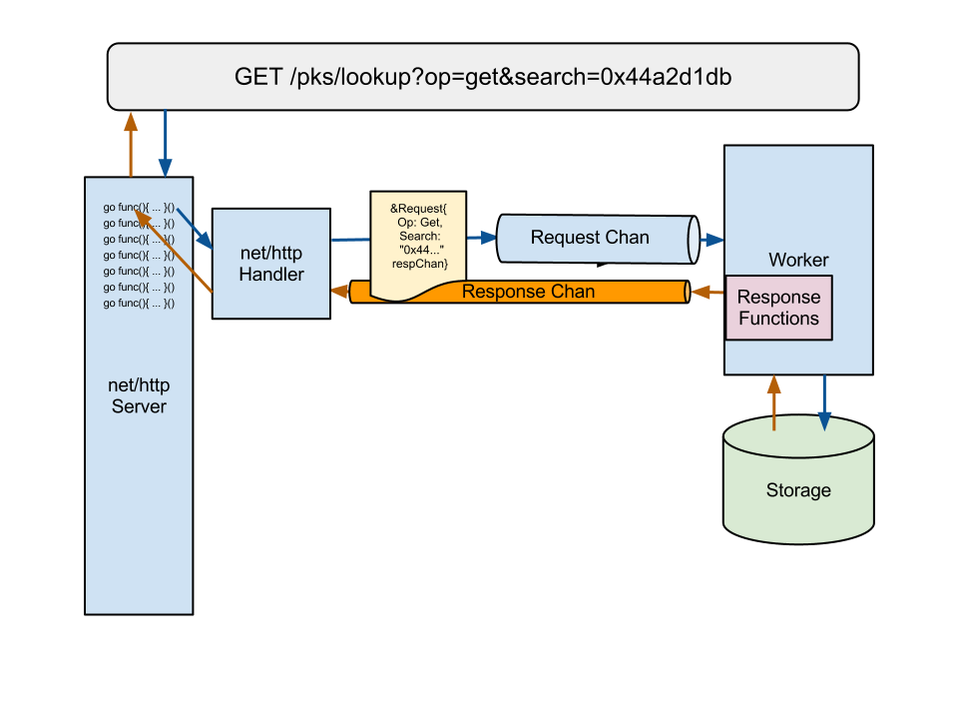
Goroutine per HTTP request
Parse to struct w/response chan
Send to workers
Worker per CPU, or specify
  Interface/DB-specific impl
Notes:
Show & Tell:
hkp_types.go: Lookup object, fields, channel, Response
responses.go: Show implementations of interface. "Static duck typing"
worker.go: This is all you need to implement, to add a new database backend.

Slide 14
Hockeypuck Schedule
Live: https://hockeypuck.gazzang.net/
  gpg --keyserver hockeypuck.gazzang.net ...
  gpg2 --keyserver hkps://hockeypuck.gazzang.net ...
Current
  Project page https://launchpad.net/hockeypuck/
  Mirror https://github.com/cmars/hockeypuck
  Hockeypuck 0.9 (ppa:hockeypuck/ppa)
Ubuntu 13.04 (Raring Ringtail)
  apt-get install hockeypuck
Notes:
Hockeypuck has been live for a few months now at hockeypuck.gazzang.net. SKS servers in the global pool provide dump files containing the entire key database. I've loaded these and I'm receiving updates from other key servers via email.
Hockeypuck was accepted into the upcoming Ubuntu 13.04 release (universe). In preparation, this week I will release Hockeypuck 0.9.

Slide 15

Lessons Learned
Notes:
> mfw MongoDB ran out of memory... again

Slide 16
MongoDB
Surprise! It's not an RDBMS!
What to index (and what not to)
Reversed fingerprint
BD1D2A44AD26397FADA207187BF98CE7EEE97218
"Full-Text Search"
Loading Performance
Aggregate updates
Notes:
My relationship with MongoDB has been interesting. Whenever I've struggled with it, I find out that I was the one doing it wrong.
Key thing I've learned about Mongo is, it makes database applications very easy to write, because your objects, your code seem to magically flow into it.
What's really happened, though, is you've moved more of the work to configuration and deployment. Of course, any database with sufficient size or transactions is like this; it will need DevOps or DBA love. Mongo just doesn't hide it from you.
When I first created my collections in Mongo, I put indexes on everything that seemed useful and searchable. Fingerprint, long key ID, short key ID, modification time, and keywords of the name and email address for a simple text search.
I found that my queries were taking a very long time (5 minutes, in some case) and sometimes timing out.
Last week at the MongoDB Austin Conference, I got some expert advice. First, they recommended a bigger instance. Fair enough, I was running in an m1.small in EC2. But how much bigger?
Well, it turns out MongoDB has a couple of interesting properties. One, all your indexes should fit in memory, with room to spare for a "working set" of cached documents. Mine didn't.
I realized that I was wasting index space. Fingerprint, long keyid and short ID are redundant. Instead, I now store the reversed fingerprint and do an anchored regex, which uses the index.
Second, I dropped the mtime index, as well as the map-reduce that was updating the stats page. Instead, I added goroutines to track these statistics and update the database every minute. I tried updating every second, but that hurt loading performance significantly.
Right now, hockeypuck.gazzang.net is happily serving 2M keys, running on an m1.small in EC2 (1.6Gb of memory on one CPU).
If this was a commercial site, this could be penny-wise and pound foolish. Most public key servers aren't startups though, they're a public service. If I can reduce the overhead and cost of running a keyserver, we're all better for it.

Slide 17
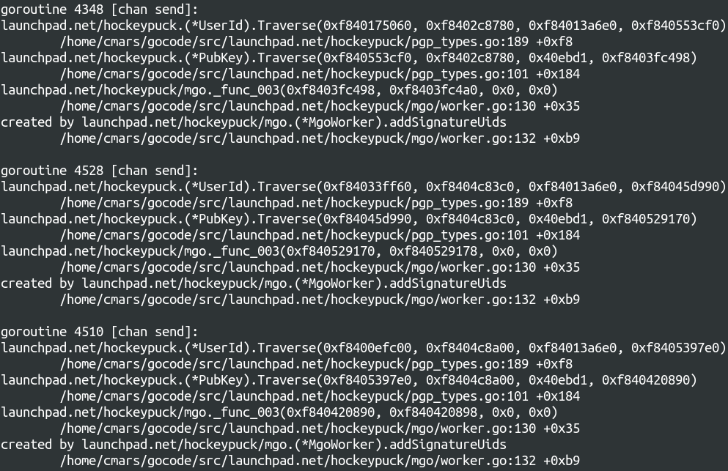
Goroutine Leaks
Notes:
I noticed in top that Hockeypuck was allocating memory and never releasing it -- the classic sign of a memory leak. It was really getting up there, too, approaching 1Gb on my poor m1.small.
But Go is garbage collected! What's going on?
I suspected a goroutine leak to be the cause. One neat feature of any compiled Go program, it will dump a stack trace of all the goroutines in the process on SIGQUIT (Ctrl-\)., some of which is shown here.
Lots and lots of goroutines, all stuck in the same place. Reading from a channel that was never closed.
After ensuring all channels were closed, Hockeypuck's resident memory stays under a modest 30mb on my EC2 instance, even under load.

Slide 18
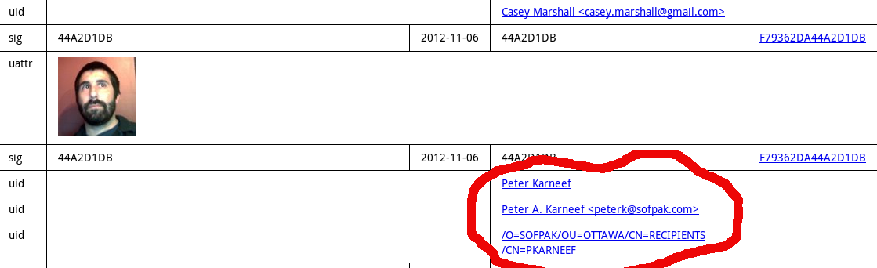
PGP Self-Signatures
Key servers are supposed to be untrusted
Signature checking "optional"?
Um...
Notes:
Last weekend while I was working out those MongoDB issues, I did a search on my own key as a preliminary check after deploying some updates...
and I find a mysterious user (let's call him PK) has been testing out my site as well. His name is listed on my key!
What happened? Was I hacked? Not really. PK must have done something like this:
He downloaded my public key
Then he added some UID packets from his own keyring (or maybe someone else's)?
Then he submitted the updated key to Hockeypuck
PGP programs like GnuPG know better than to treat the key material from a keyserver as authoritative -- they will check that the contact information, thumbnails, and subkeys are signed by the primary key. This is commonly called a self-signature.
PK's UID does not have a self-signature signed by my primary key, because *I* never signed it. Still, to avoid any confusion, and to keep a tidy, valid database, Hockeypuck should have rejected this key.
I quickly added key signature checking to Hockeypuck's public key parser, and reloaded the entire key database just to be sure.
And PK, if you're out there, thanks for the heads up!

Slide 19
State of the Puck
Loading is pretty fast...
2M keys in ~24 hours
  OpenPGP V3 signatures not yet supported
Queries are reasonably fast
Database seems to be the bottleneck!
More memory, More nodes = More requests

Slide 20
What's Next?
bugs.launchpad.net/hockeypuck
and beyond...

Slide 21
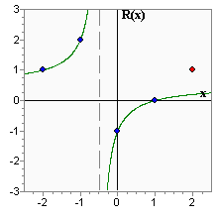

SKS Reconciliation
Distributed database reconciliation
Represent a database as a polynomial equation, differences as a ratio
Share sample points and interpolate
Conflux - https://github.com/cmars/conflux
...it's not just for keys anymore
Content-addressable things!
  Messages, images, contacts
  Folder synchronization
  Location services
Notes:
SKS reconciliation. In my opinion, this is the "killer feature" of SKS. A multi-GB database with global, eventual consistency, that anyone may add to. Distributed social networking is nothing new. SKS has been doing it quietly for 10 years!
conflux is my implementation of SKS reconciliation in Go, which I started in December 2012. GPL licensed.
My goal with conflux is to provide distributed database reconciliation as a library to any application. The service can synchronize any data that can be made content-addressable. This will have interesting applications beyond key servers.
conflux development is getting there. The mathematical aspects are passing unit tests I ported from SKS test cases. I'm still working out the network protocol and prefix-tree indexing. This is in my spare time, but I expect an initial release within a couple of months.

Slide 22
We Trust with Multiple Factors
"I trust this key because...
PGP/WoT
…it was signed by responsible PGP users.
…I met the owner in person, she verified it.
…the installation instructions contained it.
SSH
…it is the same key as first time I connected.
…it is provided by DNS, secure website, etc.
SSL/TLS
…it is signed by a certificate authority key that my browser trusts.

Slide 23
Building Trust
Add multiple factors to a key exchange
Rendezvous for key exchange
Identities beyond Email
  Build on what we already trust
  Add factors to strengthen that trust
Keep key servers distributed
Promote diversity, avoid monoculture
Spread public keys far and wide
Resistant to failure and attack

Slide 24
Identity Management
Certify yourself
  Prove identity to the keyserver
  Sign something, upload it to an account you control
  Link a public key to OpenID or OAuth accounts?
Hide yourself
  From all search results?
  Unless search request signed by these keys...
Delete yourself
  Store this key on zero or more keyservers
Decide for yourself
  Group-level visibility, certifications

Slide 25

Secure Shell

Slide 26
SSH Host Authenticity
The first connection is a leap of faith
SSHFP DNS records
What about cloud?
J-PAKE mediated by Hockeypuck
  Launch AMI with instance ID + custom metadata.
  AMI signs and pushes "PAKE shake" (exp + ZKP)
  Administrator calculates "PAKE shake" (exp + ZKP)
  Tries to connect to host.
  Look up signed "PAKE shake" by fingerprint
  Authenticate key out-of-band!
SSH, shell script wrappers & Hockeypuck

Slide 27
SSH User Authenticity
Some SSH key servers you might not know..
  Launchpad
  GitHub
$ ssh-import-id gh:cmars lp:kirkland
Add authenticity with PGP
  $ ssh-import-id pgp:0x44A2D1DB
  "Server-side Monkeysphere"?
Notes:
System administrator signs SSH host keys with her private, and distributes her public key fingerprint to users. SSH is configured to pull up-to-date signatures and revocations on SSH host keys prior to connection.
This is not a new idea, it's essentially what the Monkeysphere project does. By adding server-side support, could we make it easier to deploy an SSH web-of-trust or PKI?

Slide 28

Certificate Authorities

Slide 29
Certificate Authorities
"Too big to fail"?
Really means "brings failure to others"
Or, "you're not trying hard enough"
Convergence.io protocol, act as notary
PGP signatures on certificates

Slide 30
Thank You!

